Slide 1
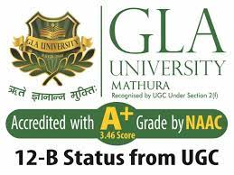
BCA Ist Semester
PROBLEM SOLVING USING COMPUTER
Course Code: BCAC 0018
Presented by:
Mr.Shivank Chauhan
Dept. Of CEA
GLA University, Mathura

Slide 2
Components of a Digital Computer
A computer is a programmable machine. The two main characteristics of a computer are:
(i) It responds to a specific set of instructions in a well-defined manner.
(ii) It can execute a pre-recorded list of instructions (a program).
Modern computers are electronic and digital.
The actual machinery - wires, transistors and circuits is called hardware;
The instructions and data are called software.

Slide 3
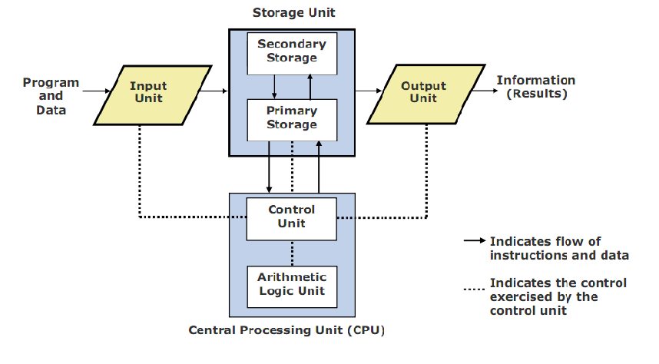
Basic units of computer

Slide 4
1.Central Processing Unit (CPU)
executes program instructions
the CPU is based on a single electronic component, the microprocessor chip, within the system unit or system cabinet.
The system unit also includes circuit boards, memory chips, and other components.
The CPU has two parts -The Control Unit (CU) and the Arithmetic Logic Unit (ALU).
In a microcomputer, both are on a single microprocessor chip.

Slide 5
a. Control Unit (CU)
The control unit tells the rest of the computer system how to carry out a program’s instructions.
It directs the movement of electronic signals between memory and the ALU.
It also directs these control signals between the CPU and input/output devices.

Slide 6
b. Arithmetic - Logic Unit (ALU)
Arithmetic Logic Unit, performs two types of operations - arithmetical and logical.
Arithmetical mathematical operations consisting of addition, subtraction, multiplication and division.
Logical operations consist of comparisons.
That is two pieces of data are compared to see whether one is equal to, less than, or greater than the other.

Slide 7
2. Storage Unit
Stores instructions and/or data required for processing.
Stores the intermediate results of processing.
Final results of processing before they are released to an output device.
The memory unit also serves as a storage for intermediate and final results of arithmetic operations.

Slide 8
3. Input Unit
It accepts (or read) instructions and data from outside world.
It converts these instructions and data in computer acceptable form.
It supplies the converted instructions and data to the computer system for further processing.
Example of input device: Keyboard, Mouse, Scanner, etc.

Slide 9
4. Output Unit
It accepts the results produced by the computer, which are in coded form and hence, cannot be easily understood by us.
It converts these coded results to human acceptable(readable) form.
It supplies the converted results to outside world.
Output Device: Monitor, Printer, Speaker, etc.

Slide 10
Characteristics of Computer
SPEED : In general, no human being can compete to solving the complex computation, faster than computer.
ACCURACY : Since Computer is programmed, so what ever input we give it gives result with accurately.
STORAGE : Computer can store mass storage of data with appropriate format.
DILIGENCE : Computer can work for hours without any break and creating error.
VERSATILITY : We can use computer to perform completely different type of work at the same time.
NO IQ : Computer does not work without instruction.
NO FEELING : Computer does not have emotions, knowledge, experience, feeling.

Slide 11
END

